Slide 1
Growth Mindset day 5
Room 123

Slide 2
Conjecture
A conjecture is a proposition that is consistent with known data, but hasn’t been proven… yet! In science we call this a hypothesis, in math a conjecture.

Slide 3
Hailstone Sequence (12 – 15 minutes)
Describe what you notice about this sequence
20 – 10 – 5 – 16 – 8 – 4 – 2 – 1

Slide 4
Hailstone Sequence Rules
If a number is even, divide it by 2
If a number is odd, multiply by 3 and add 1

Slide 5
Collatz’ Conjecture (8 – 12 minutes)
Start with any number and follow the previous pattern… what do you notice?

Slide 6
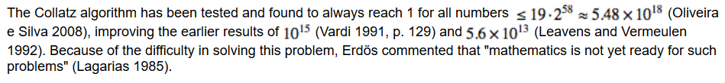
Interesting Fact
In other words, although this appears to always work, there isn’t enough to prove that it is in fact always true… it is one of mathematics unsolved problems!

Slide 7
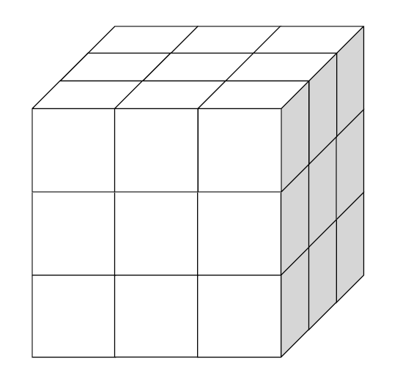
If you were to dip this
cube into paint, then
separate the large cube
into individual cubes, how
many of the small cubes
would have paint on…
0 side? 1 side?
2 sides? 3 sides?
more?
Justify your answer(s).

Slide 8
Reflection on first 5 days
What do you want me to know about you in order to make this year the best year you’ve had in a math classroom?

Slide 9
Our Brains Think about Math Video (3 minutes)
https://bhi61nm2cr3mkdgk1dtaov18-wpengine.netdna-ssl.com/wp-content/uploads/2017/03/Our-Brains-Think-about-Math-Visually.mp4

Slide 10
Class Specific Slides

